Slide 1


ITU - EACO
WORKSHOP ON EMERGING TECHNOLOGIES
SESSION 4: INTRODUCTION TO AI

Slide 2
OBJECTIVES
DECIPHER WHAT IS AI BEYOND MEDIA HYPE
REALIZE MOMENTUM FOR WIDE SCALE AI IMPLEMENTATION
IDENTIFY OPPORTUNITIES AND CHALLENGES
OVERVIEW OF FORTHCOMING SESSIONS

Slide 3
PRELIMINARY QUIZ
AI WAS INVENTED 10 YEARS AGO
AI RESEARCH ACHIEVES MAJOR BREAKTHROUGHS EVERY 6 MONTHS
AI WILL REPLACE 50% OF ALL JOBS IN 10 YEARS
US LEAD IN AI IS ABSOLUTELY UNDENIABLE
AI IMPLEMENTATION AT LARGE SCALE IS WELL MARKED OUT

Slide 4
HEADLONG INTO MACHINE LEARNING AND AI

Slide 5
ARTHUR SAMUEL IN 1959
“MACHINE LEARNING IS THE FIELD OF STUDY THAT GIVES COMPUTERS THE ABILITY TO LEARN WITHOUT BEING EXPLICITLY PROGRAMMED”

Slide 6
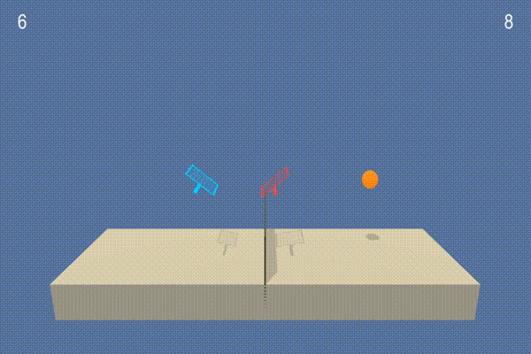
WHEN YOUR MACHINE LEARNS PLAYING TENNIS
BEFORE
TRAINING

Slide 7
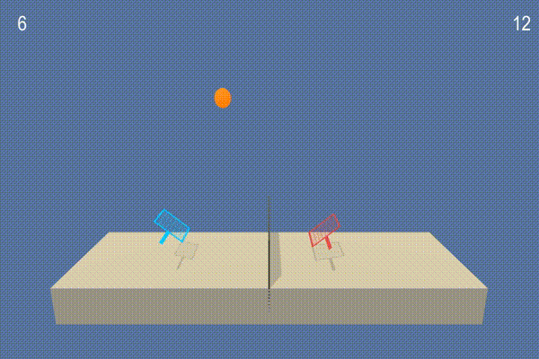
WHEN YOUR MACHINE LEARNS PLAYING TENNIS
AFTER
TRAINING
< 5 min laptop

Slide 8
WHY DO WE CALL IT INTELLIGENCE?
CONTROVERSIAL AND VAST SUBJECT …

Slide 9
SOME QUOTES
“Intelligence is the ability to adapt to change” – Stephen Hawking
“Intelligence is the ability to avoid doing work, yet getting the work done” – Linus Torvalds
“The true sign of intelligence is not knowledge but imagination” – Albert Einstein
“The intelligent man who is proud of his intelligence is like the condemned man who is proud of his large cell” – Simone Weil

Slide 10
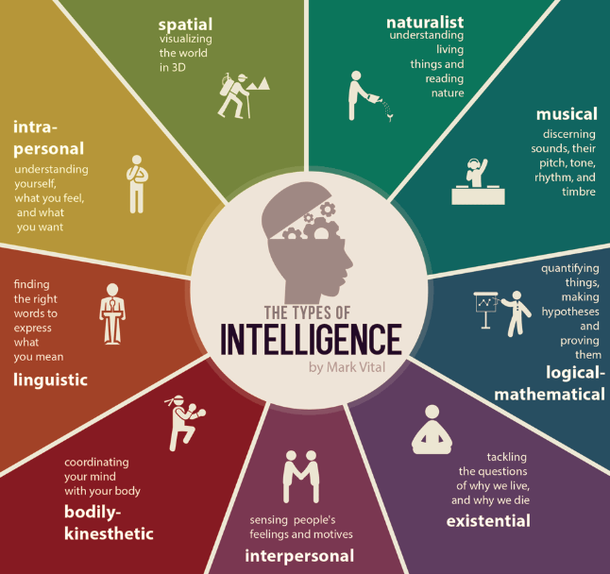
Source: https://blog.adioma.com/9-types-of-intelligence-infographic/

Slide 11
INTELLIGENCE IN A NARROWER SENSE

Slide 12
WHAT’S IN COMMON ?
PREDICTING STOCK MARKET PRICE
PREDICTING WHO IS IN THIS VIDEO
PREDICTING A SERIOUS DISEASE
PREDICTING SELLS FOR NEXT MONTHS
…

Slide 13
WHAT IS PREDICTION?
THE PROCESS OF FILLING MISSING INFORMATION
PREDICTIONS TAKE INFORMATION YOU HAVE [DATA]
AND USES IT TO GENERATE INFORMATION YOU DON’T HAVE

Slide 14
AI TRANSFORMATIONAL POWER
BETTER PREDICTIONS MAY TRANSFORM BUSINESS MODEL
BETTER PREDICTIONS IMPLY RETHINKING WORKFLOWS
BETTER PREDICTIONS IMPLY RETHINKING HR ROLES
BETTER PREDICTIONS IMPLY RETHINKING HUMAN-MACHINE INTEGRATION AT GLOBAL SCALE

Slide 15
UNPACKING DECISION MAKING
PREDICTION IS ONLY ONE KEY ELEMENT WITH
JUDGMENTS
ACTIONS
OUTCOME & FEEDBACK
Notes:
Decision making under uncertainty
Human are not so good at predicting, confirmation bias,

Slide 16
HUMAN & AI
AI BEATS HUMAN IN PREDICTION IN MANY NARROW TASKS
HUMAN ARE BETTER WHEN FEW DATA [MODEL OF THE WORLD]
HUMAN PUT PREDICTIONS INTO CONTEXT AND ASSESS TRADEOFFS
REQUIRE RETHINKING MANY JOBS
https://en.wikipedia.org/wiki/Thinking,_Fast_and_Slow
Notes:
CONFIRMATION BIAS
Daniel Kahneman, nobel prize, 2002

Slide 17

IDENTIFY 5 AI APPLICATIONS
WHAT DOES IT PREDICT?
Notes:
If not proposed:
Weather forecast
Plant disease
…

Slide 18
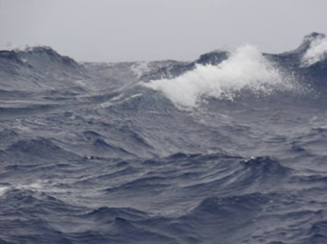
BRIEF OVERVIEW OF AI HISTORY
BOOM AND BUST CYCLES

Slide 19
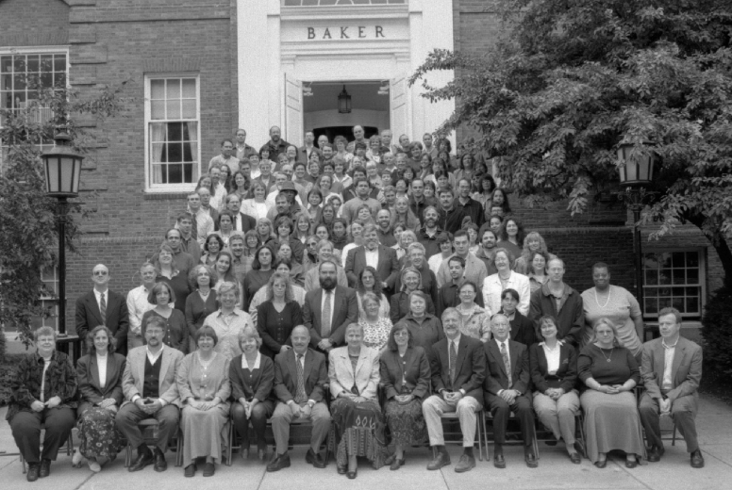
DARTMOUTH SEMINAL WORKSHOP [1956]
Marvin Minsky
John McCarthy
Claude Shannon
Herbert Simon
John Nash
Arthur Samuel
…
Notes:
Marvin Minsky, John MacCarthy, Claude Shannon, Herbert Simon, John Nash, Arthur Samuel
What did they do?
Minsky:
John Nash
Claude Shannon

Slide 20
THE PROPOSAL
« An attempt will be made to find how to make machines use language, form abstractions and concepts, solve kinds of problems now reserved for humans, and improve themselves.
…
For the present purpose the artificial intelligence problem is taken to be that of making a machine behave in ways that would be called INTELLIGENT IF A HUMAN WERE SO BEHAVING. »

Slide 21
THE PROMISED RESULTS
« We think that a significant advance can be made in one or more of these problems if a carefully selected group of scientists work on it together for a summer »
UNDERESTIMATED DIFFICULTY

Slide 22
JOIN DARTMOUTH WORKSHOP
TEAM A SECOND AND DEVISE AN INTELLIGENT SYSTEM

Slide 23
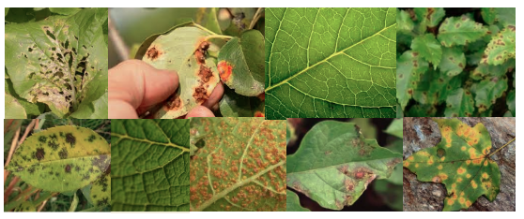
HOW WOULD YOU DETECT DISEASE?

Slide 24
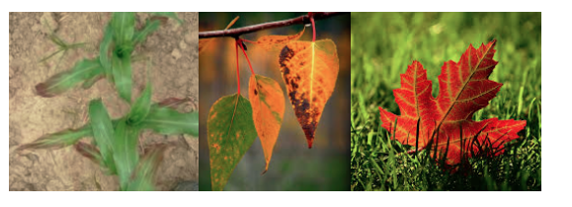
WHAT ABOUT THESE ONES?
Notes:
The limit of hard rule-based approach.

Slide 25
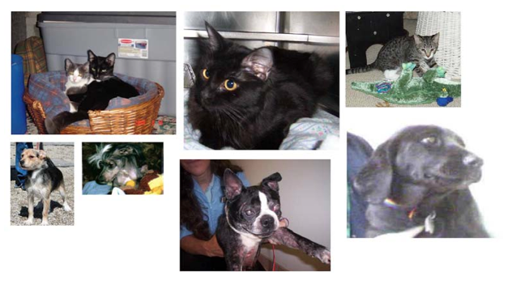
AND THIS CLASSIFICATION TASK?
https://www.kaggle.com/c/dogs-vs-cats
Notes:
The limit of hard rule-based approach.

Slide 26
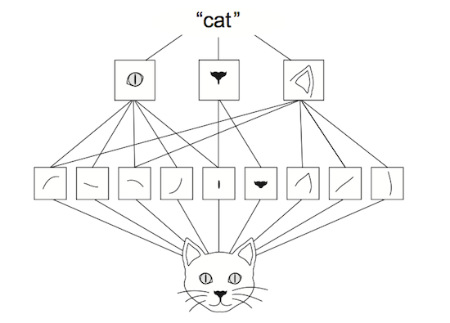
CONVOLUTIONAL NEURAL NETWORKS
Hands-On Machine Learning with Scikit-Learn & TensorFlow, O'Reilly, 2017
Notes:
Emerged from the study of brain’s visual cortex
To be discussed later on .

Slide 27
TWO MAIN SCHOOLS OF THOUGHTS [1950s - 60s]
TOP DOWN - RULE-BASED – SYMBOLIC EXPERT SYSTEM
BOTTOM UP - NEURAL NETWORKS AS AN ATTEMPT TO MIMIC BRAIN
Notes:
Logic based – domain knowledge of prime importance – Series of logical rules, ifs – Solving toy problems
Neural Networks – agnostic/learn by itself
Top

Slide 28
THE FIRST AI WINTER [1970s]
LACK OF PRACTICAL RESULTS
EXPECTATIONS RAISE TO HIGH
CONTROVERSY BETWEEN DIFFERENT SCHOOLS OF THOUGHT

Slide 29
STINTS OF PROMINENCE [1980s]
RISE OF EXPERT SYSTEMS FOLLOWED BY
NEAR TOTAL ABANDONMENT
Notes:
Why?

Slide 30
PROLONGED ICE IN THE [1990s] DESPITE
MORE DATA
MORE COMPUTING POWER

Slide 31
THE AI CONSPIRACY [MID-2000s]
HINTON, BENGIO, LECUN, …
HOW TO BEST USE/TRAIN NEURAL NETWORKS (NN)
RE-BRANDED NN AS DEEP LEARNING
Notes:
Logic based – domain knowledge of prime importance
Neural Networks – agnostic/learn by itself

Slide 32
EVERYBODY BUZZING ABOUT [2010s]
MAJOR BREAKTHOUGHS – IMAGE NET CONTEST
USE OF GPUs
HUGE AMOUNT OF DATA HARNESSED
OPTIMIZATION TRICKS
…

Slide 33
DECYPHERING AI JARGON
SUPERVISED, UNSUPERVISED, REINFORCEMENT LEARNING, …

Slide 34




SUPERVISED LEARNING
MODEL
NEW RESPONSE
KNOWN DATA
?
THESE ARE CATS
KNOWN RESPONSE
NEW DATA
Notes:
https://www.quora.com/What-is-the-difference-between-supervised-and-unsupervised-learning-algorithms

Slide 35


UNSUPERVISED LEARNING
I CAN SEE A PATTERN
MODEL
INPUT DATA
Notes:
https://www.quora.com/What-is-the-difference-between-supervised-and-unsupervised-learning-algorithms

Slide 36


REINFORCEMENT LEARNING
ENVIRONMENT
OBSERVE ITS STATE
GET REWARD
ACT
AGENT
Notes:
https://www.quora.com/What-is-the-difference-between-supervised-and-unsupervised-learning-algorithms

Slide 37
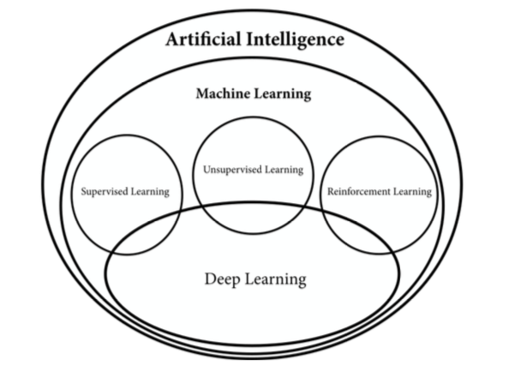
REBRANDING & CONFUSION
DIFFERENCE BETWEEN AI & MACHINE LEARNING?
WHAT IS DATA SCIENCE?
DEEP LEARNING OR DEEP NEURAL NETWORKS?
Source: https://www.manning.com/books/grokking-deep-reinforcement-learning

Slide 38
LURING WITH SIREN SONGS?
“DATA IS THE NEW OIL”
“AI IS THE NEW ELECTRICITY”
“THE FOURTH INDUSTRIAL REVOLUTION”
…
Notes:
Might be valid statement but what is marketing, what is branding, what is real ?
The risk of many expectations that could be disappointed …
First IR: iron, textile industry with steam machine 18th-19th
Second IR: oil and electricity – before first world war
Third IR: Digital revolution – after 80’s
Fourth: now ??

Slide 39
WHAT ARE AI KEY ENABLERS?
TECHNOLOGY, SCIENCE, BUSINESS, SOCIAL, POLICY, …

Slide 40
ON TECHNOLOGICAL SIDE
MORE DATA
COMPUTING POWER (GPU)
OPTIMIZATION OF LEARNING ALGORITHMS

Slide 41
ON SCIENTIFIC SIDE
EXTREMELY ACTIVE SCIENTIFIC RESEARCH WORLDWIDE
DEMOCRATIZATION / OPEN SOURCE / EDUCATION / SaaS
MAJOR BREAKTRHOUGHS

Slide 42
ON BUSINESS SIDE
FROM INNOVATION TO IMPLEMENTATION “ERA”
HARNESSING THE “NARROW” AI
INFINITE DOMAIN APPLICATIONS
INDUSTRIALIZATION

Slide 43
ON SOCIETAL & POLICY SIDES
PUBLIC AWARENESS THROUGH MEDIA HYPE
RACE FOR AI AS A GEOPOLOTICAL STAKE
DIGITALIZATION OF THE SOCIETY ALREADY STARTED IN MANY COUNTRIES

Slide 44
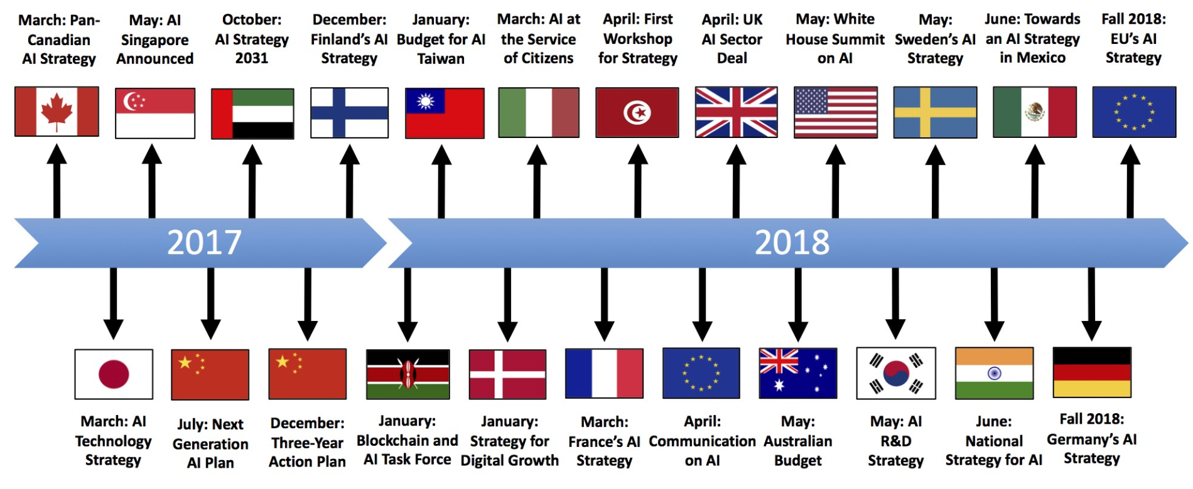
AN IDEA OF THE RUSH …
Source: https://medium.com/politics-ai/an-overview-of-national-ai-strategies-2a70ec6edfd
Notes:
Own strong strategy otherwise risk of becoming a Cyber-colony

Slide 45
THE STUFF OF AN AI SUPERPOWER
ABUNDANT DATA
TENACIOUS ENTREPRENEURS [ON STRATEGIC SECTORS]
WELL-TRAINED AI SCIENTISTS
SUPPORTIVE POLICY ENVIRONMENT [ON STRATEGIC SECTORS]
https://aisuperpowers.com/
Notes:
Strategic sectors may vary according to the country/region: healthcare in France, Manufacturing in China, …

Slide 46
WHAT ARE AI CHALLENGES?
ETHICS, SOCIETAL, TECHNOLOGY, …

Slide 47
TECHNOLOGICAL/SCIENTIFIC SIDES
UNDERSTAND WHY DOES IT WORK SO WELL !!
PREDICTION ON LONG TERM HORIZON
UNSUPERVISED LEARNING -> BUILD A MODEL OF THE WORLD FROM SCRATCH

Slide 48
ON BUSINESS SIDE
TRANSITION TO INDUSTRIALIZATION
WELL-TRAINED ENGINEERS
EAGER ENTREPRENEURS

Slide 49
ON SOCIETAL & POLICY SIDES
MANY ETHICAL CONSIDERATIONS
INFORMED AND AMBITIOUS POLICIES
HUGE SOCIAL IMPACT TO ANTICIPATE (EMPLOYMENT, …)
Notes:
Policy on data, entrepreneurship, delegation, multidisciplinary research, education, public awareness, ethical committees, …

Slide 50
AI IS A MATTER OF TRADEOFFS
MORE DATA => LESS PRIVACY
MORE AUTONOMY => LESS CONTROL
MORE SPEED => LESS ACCURACY

Slide 51
AI IN AFRICA
FOR A PAN-AFRICAN STRATEGY SETTING UP ROADMAP ?

Slide 52
NO EXCEPTION PAN-AFRICAN STRATEGY
TO ENCOURAGE AI EDUCATION
TO INCENTIVIZE ENTREPRENEURSHIP [STRATEGIC SECTORS?]
TO FACILITATE COOPERATION
TO MOBILIZE HUMAN & FINANCIAL RESOURCES
Notes:
More than 1.2 billion people
Median age is 19 while in Europe 43 (me)
What are strategic sectors in Africa for AI
US$560 million VC in 2017 (60 of them through Google Launchpad accelerator)

Slide 53
RECENT INITIATIVES IN EDUCATION & RESEARCH
AFRICAN MASTER IN MACHINE INTELLIGENCE (AMMI), AIMS KIGALI, RWANDA
DEEP LEARNING INDABA GATHERINGS
GOOGLE RESEARCH LAB IN ACCRA, GHANA
ZINDI (KAGGLE FOR AFRICA)
https://aims-ammi.com/
http://www.deeplearningindaba.com/
https://zindi.africa/competitions
Notes:
African Institute for Mathematical Science (African Master of Machine Intelligence) – Google, Facebook sponsorship
Exemple of applications but will be shown on later presentations

Slide 54
FORTHCOMING SESSIONS

Slide 55
AI APPLICATIONS ETHICS OF AI
OPEN ISSUES
BUSINESS MODEL
&
WORKING GROUP SESSIONS

